Slide 1
Performance Evaluation Method
- Technique for Order Preference by Similarity to Ideal Solution (TOPSIS)
Rong-Tsu Wang

Slide 2
Origin and History
1980: development by Kwangsun Yoon and Hwang Ching-Lai
  Yoon, K., “System Selection by Multiple Attribute Decision Making,” Ph. D. Dissertation, Kansas State University, Manhattan, Kansas, 1980.
  Yoon, K. and C. L. Hwang, “TOPSIS (Technique for Order Preference by Similarity to Ideal Solution)- A Multiple Attribute Decision Making,” a paper to be published, 1980.

Slide 3
Basic Concept-1
the chosen alternative should have the shortest distance from the ideal solution and the farthest from the negative-ideal solution

Slide 4
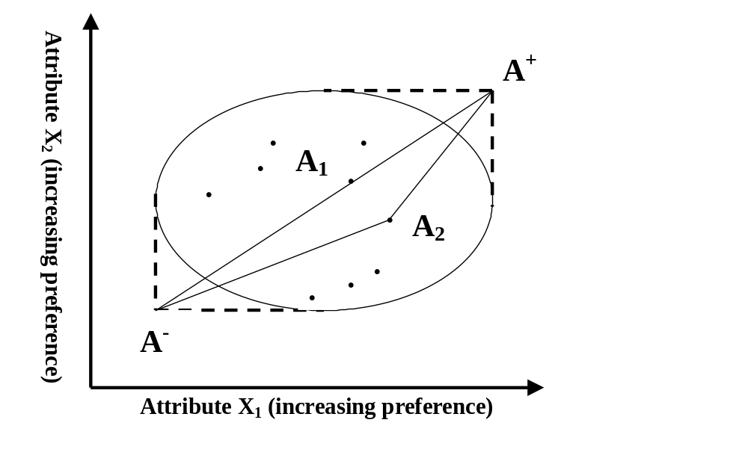
Basic Concept-2
  It is very difficult to justify the selection of A₁

Slide 5
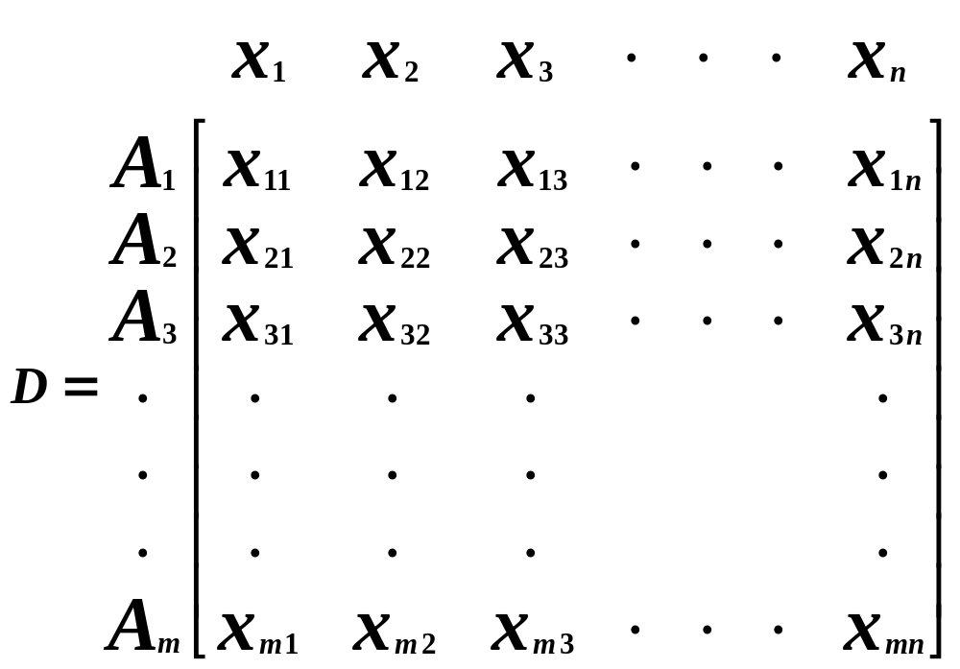
Decision Matrix
m alternative, n attributes (or criteria)

Slide 6
Hypothesis-1
each attribute in the decision matrix takes either monotonically increasing or monotonically decreasing utility

Slide 7
Hypothesis-2
a set of weights for the attributes is required

Slide 8
Hypothesis-3
any outcome which is expressed in a non-numerical way should be quantified through the appropriate scaling technique

Slide 9
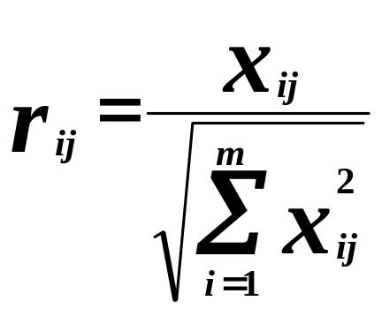
Steps-1
Construct the normalized decision matrix
  to transform the various attribute dimensions into non-dimensional attributes, which allows comparison across the attributes

Slide 10
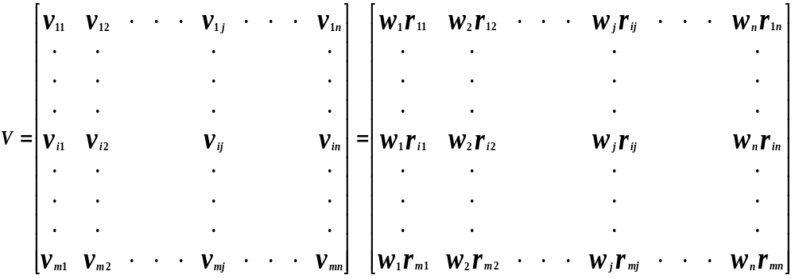
Steps-2
Construct the weighted normalized decision matrix

Slide 11
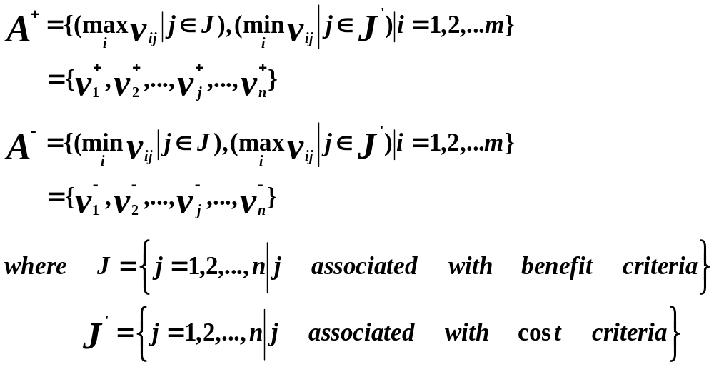
Steps-3
Determine ideal and negative-ideal solutions

Slide 12
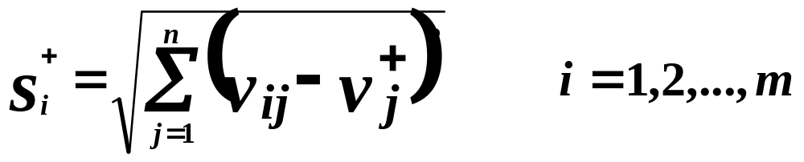

Steps-4
Calculate the separation measure
  ideal separation
  negative-ideal separation

Slide 13
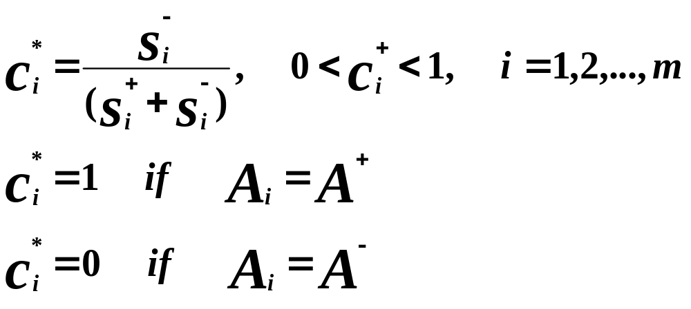
Steps-5
Calculate the relative closeness to the ideal solution

Slide 14

Steps-6
Rank the preference order
  A set of alternatives can now be preference ranked according to the descending order of

Slide 15
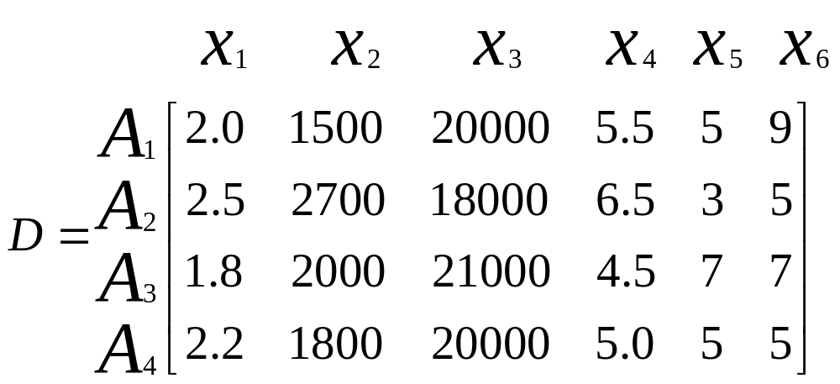
Numerical Example
decision matrix

Slide 16
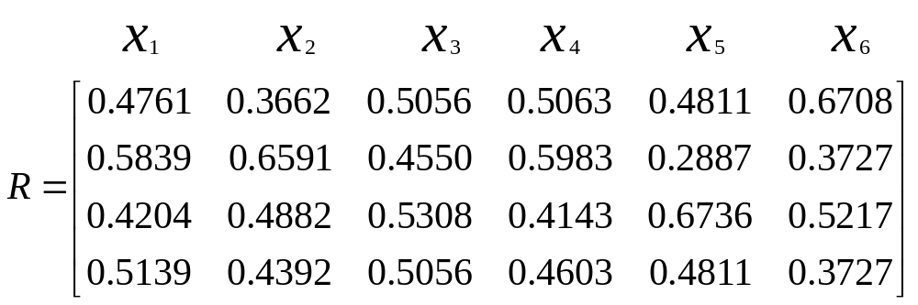
Numerical Example
normalized decision matrix

Slide 17
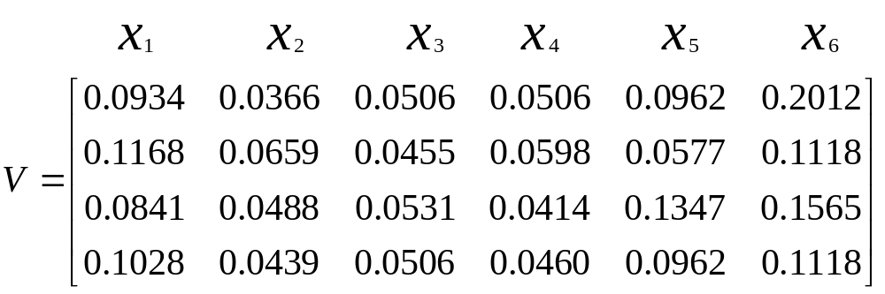
Numerical Example
weighted decision matrix

Slide 18
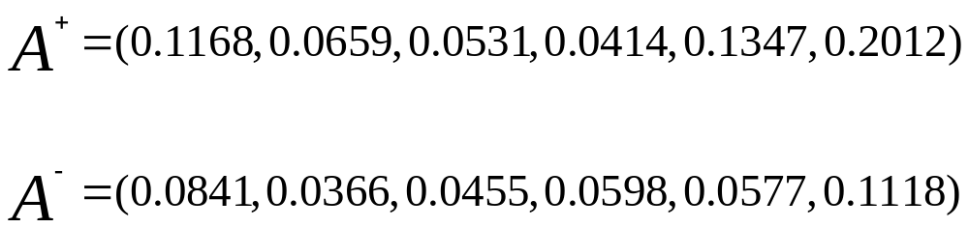
Numerical Example
the ideal and negative-ideal solutions

Slide 19
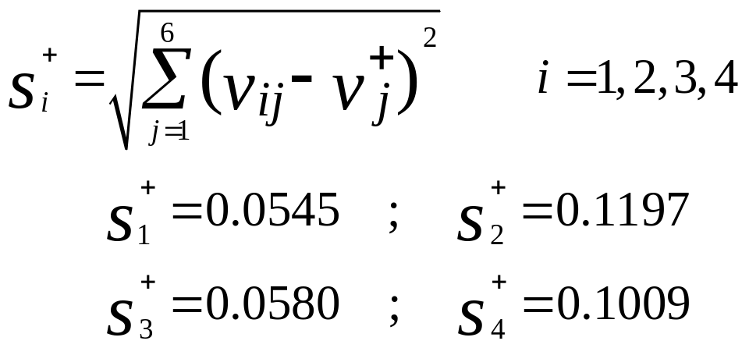
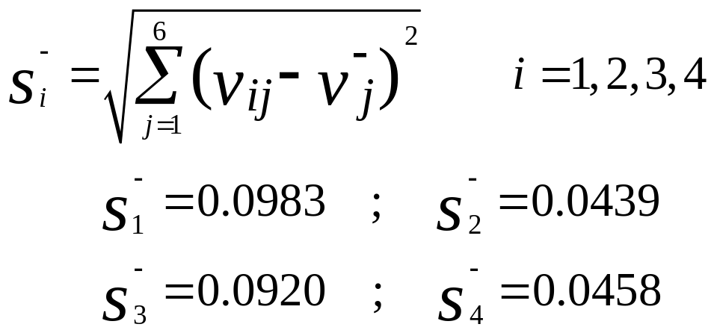
Numerical Example
separation measures

Slide 20
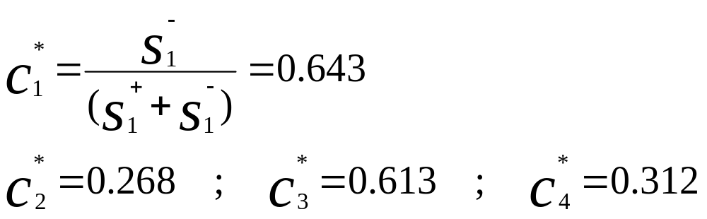
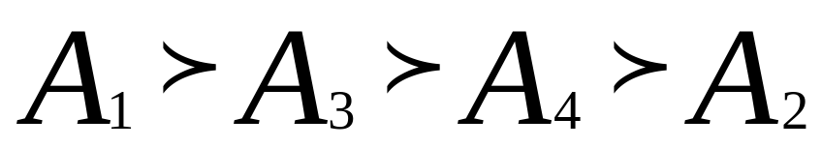
Numerical Example
the relative closeness to the ideal solution
rank the preference order

